Slide 1
Machine Learning-Based Driver Assistant System to Reduce Road Accidents
CDAP 24_25J_197

Slide 2
Project Introduction
Aims to improve road safety in Sri Lanka by addressing issues like reckless driving and poor road sign detection.
The ultimate goal is to reduce accidents and improve the overall driving experience.
Used machine learning algorithms to make a solution for the overall problems mentioned.

Slide 3
Research Problem
High Rate of Road Accidents in Sri Lanka.
Risky and undisciplined driver behavior.
Lack of vehicle security.
Lack of proper road signs and unclear lane markings in Sri Lanka.
Current systems are insufficient to address the root causes of accidents.

Slide 4
Research Objectives
Enhance driver safety Provide real-time intelligent assistance to reduce the risk of accidents.
Increase driver confidence Support novice drivers with guidance and feedback.
Improve navigation Detect and interpret road signs, lanes, and traffic lights.
Promote responsible driving Offer immediate alerts and feedback to ensure safe driving practices.

Slide 5
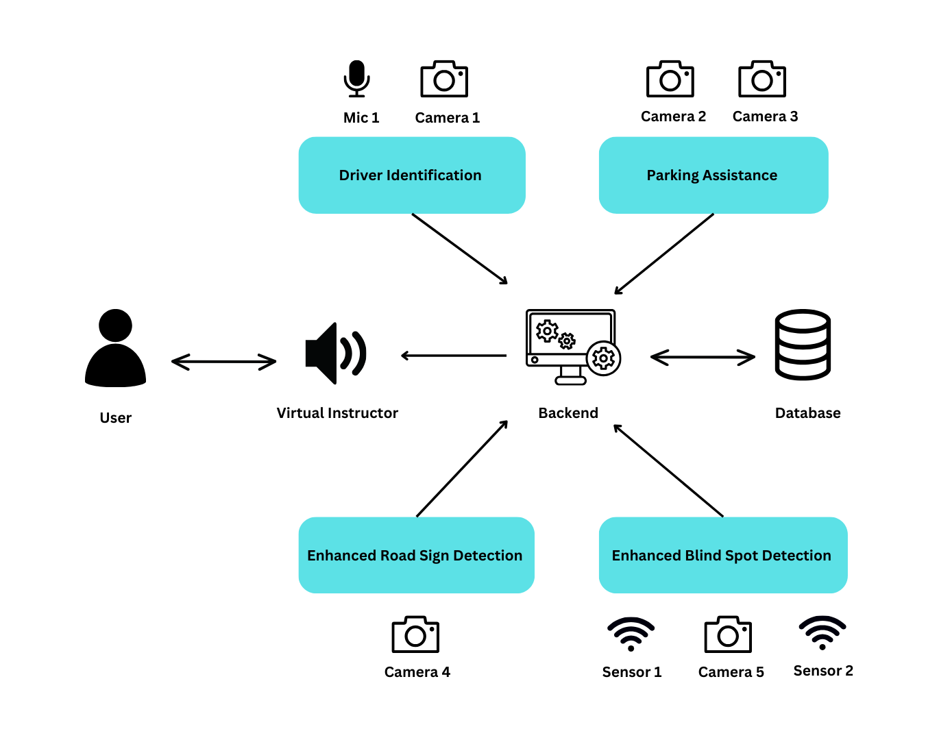
Overall System Diagram

Slide 6
Somarathne R.M.B.C. | IT21210938
BSc (Hons) in information Technology Specialized in Information Technology
IT21210938 | Somarathne R.M.B.C. | CDAP_24_25J_197

Slide 7
Introduction
Advanced biometric authentication for validating drivers
Captures a voice sample through the vehicle’s microphone and compares it to stored voice profiles of drivers.
The system maps facial landmarks and compares the captured data to stored profiles.
When an unauthorized driver is detected, the system can immediately send a security alert to the owner’s smartphone or connected device.
IT21210938 | Somarathne R.M.B.C. | CDAP_24_25J_197

Slide 8
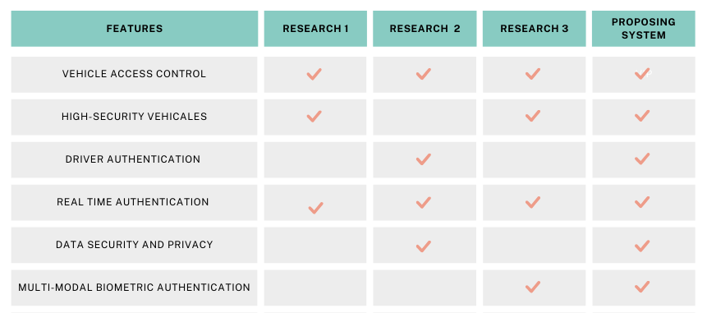
Research Gap
IT21210938 | Somarathne R.M.B.C. | CDAP_24_25J_197

Slide 9
Research Questions
How to improve the security by voice and face recognition in vehicles?
How can a security messaging system effectively alert owners of unauthorized access?
IT21210938 | Somarathne R.M.B.C. | CDAP_24_25J_197

Slide 10
Specific Objective
Develop an advanced biometric authentication system for validating drivers.
Sub Objectives
Voice-Based Driver Identification
Driver Face Identification
Security Messaging System
IT21210938 | Somarathne R.M.B.C. | CDAP_24_25J_197

Slide 11
Methodology
IT21210938 | Somarathne R.M.B.C. | CDAP_24_25J_197

Slide 12
Technologies to be used
Hardwares
Microphone
Camera
Processing Unit (Embedded System)
Connected Device (Smartphone or similar)
Softwares
Python with LibROSA for voice processing.
OpenCV and Dlib for facial recognition.
IT21210938 | Somarathne R.M.B.C. | CDAP_24_25J_197

Slide 13
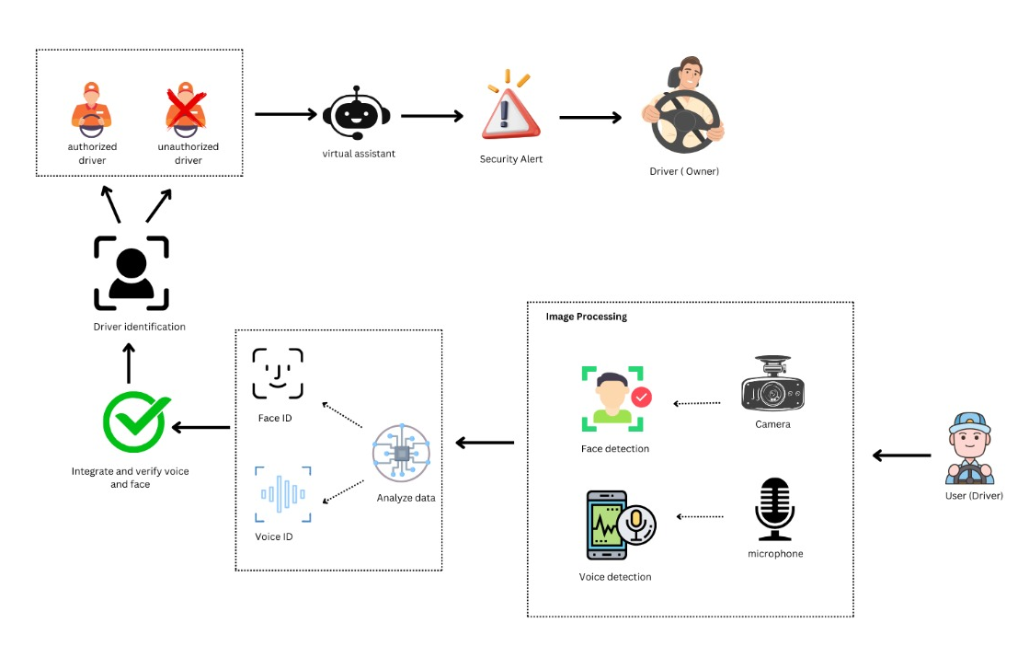
System Diagram
IT21210938 | Somarathne R.M.B.C. | CDAP_24_25J_197

Slide 14
Functional Requirements
Capture and process the driver's voice and facial features.
Match the captured voice and facial data against stored profiles.
The system must send an alert to the owner’s device if an unauthorized driver is detected.
IT21210938 | Somarathne R.M.B.C. | CDAP_24_25J_197

Slide 15
Non-Functional Requirements
Real-time process biometric data.
High accuracy in voice and face data.
Reliability of the system.
Data privacy and security of driver profiles.
IT21210938 | Somarathne R.M.B.C. | CDAP_24_25J_197

Slide 16
Personal Requirements
Project Manager: Oversees project progress, manages resources.-
Software Developers: Develop and integrate voice and face recognition modules.
QA Engineer: Ensures system functionality and reliability through rigorous testing.
IT21210938 | Somarathne R.M.B.C. | CDAP_24_25J_197

Slide 17
Commercialization
Target Market & Needs.
Marketing, Sales, & Compliance.
IT21210938 | Somarathne R.M.B.C. | CDAP_24_25J_197

Slide 18
Budget
Resourses | Amount (LKR)
Accessories Cost | 4000
Electricity cost | 2000
Internet Cost | 3500
Travelling Cost | 8000 (for all)
IT21210938 | Somarathne R.M.B.C. | CDAP_24_25J_197

Slide 19
References
[1] World Bank, "Delivering Road Safety in Sri Lanka: Leadership Priorities and Initiatives to 2030," [Online]. Available: https://documents.worldbank.org/curated/en/976361582088610795/pdf/Delivering-Road-Safety-in-Sri-Lanka-Leadership-Priorities-and-Initiatives-to-2030.pdf.
[2] "Prioritizing Road Safety: A Global Challenge and Sri Lanka's Perspective," Numbers.lk, [Online]. Available: https://numbers.lk/news/prioritizing-road-safety-a-global-challenge-and-sri-lanka-s-perspective.
[3] N. D. Sinclair, "Three Ways to Improve Road Safety in Sri Lanka," Asian Development Blog, 15-Jan-2024, [Online]. Available: https://blogs.adb.org/blog/three-ways-improve-road-safety-sri-lanka.
IT21210938 | Somarathne R.M.B.C. | CDAP_24_25J_197

Slide 20
Wijerathne G.A.R. | IT21349638
BSc (Hons) in information Technology Specialized in Information Technology
IT21349638 | Wijerathne G.A.R. | CDAP_24_25J_197

Slide 21
Introduction
Road signs and road condition detection for enhancing safe driving
This system detects and recognizes different weather conditions.
This enhances the driver’s understanding of road signs through audio narration, even if they are not familiar with the signs.
This involves creating a system that alerts the driver about upcoming speed limits and road bends to enhance safety.
IT21349638 | Wijerathne G.A.R. | CDAP_24_25J_197

Slide 22
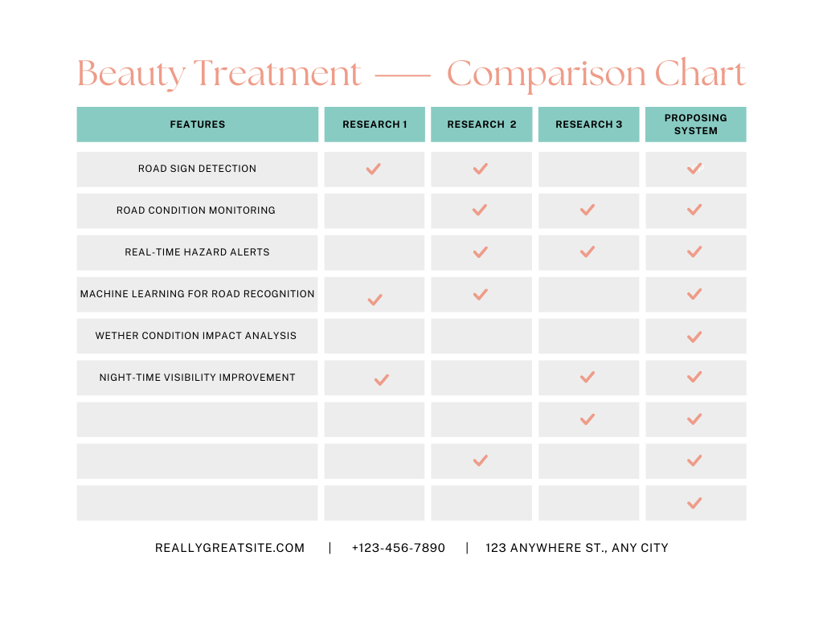
Research Gap
IT21349638 | Wijerathne G.A.R. | CDAP_24_25J_197

Slide 23
Research Questions
How can we ensure the accuracy of road sign recognition in various environmental conditions?
How can an integrated driver assistance system effectively combine the suggested features?
IT21349638 | Wijerathne G.A.R. | CDAP_24_25J_197

Slide 24
Specific Objective
Develop an advanced road sign and road condition detection system.
Sub Objectives
Evaluate the Accuracy and Reliability of the Recognition Systems
Enhance User Interface for Real-Time Feedback
Optimize System Performance for Real-World Application
IT21349638 | Wijerathne G.A.R. | CDAP_24_25J_197

Slide 25
Methodology
IT21349638 | Wijerathne G.A.R. | CDAP_24_25J_197

Slide 26
Technologies to be used
Hardwares
Camera
Processing Unit (Embedded System)
Connected Device (Smartphone or similar)
Softwares
OpenCV for image processing.
TensorFlow or PyTorch for machine learning models.
Python for backend processing.
JavaScript and HTML5 for user interface.
SQLite or MySQL for data storage.
IT21349638 | Wijerathne G.A.R. | CDAP_24_25J_197

Slide 27
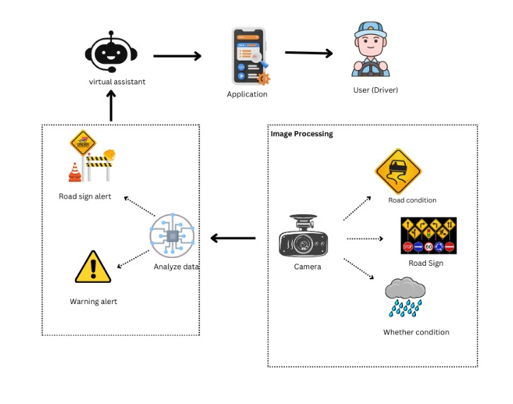
System Diagram
IT21349638 | Wijerathne G.A.R. | CDAP_24_25J_197

Slide 28
Functional Requirements
Road Sign Recognition
Climate Condition Detection
Speed Limit and Bend Alerts
IT21349638 | Wijerathne G.A.R. | CDAP_24_25J_197

Slide 29
Non-Functional Requirements
Performance
Reliability
Usability
Security
IT21349638 | Wijerathne G.A.R. | CDAP_24_25J_197

Slide 30
Personal Requirements
Project Manager: Oversees project progress, manages resources.
Software Developers: Develop and integrate modules.
QA Engineer: Ensures system functionality and reliability through rigorous testing.
IT21349638 | Wijerathne G.A.R. | CDAP_24_25J_197

Slide 31
Commercialization
First, recognize the target audience.
Create a blog for our application.
Add our application to review websites.
Create a social media marketing plan.
IT21349638 | Wijerathne G.A.R. | CDAP_24_25J_197

Slide 32
Budget
Resourses | Amount (LKR)
Accessories Cost | 2000
Electricity cost | 1800
Internet Cost | 3500
Travelling Cost | 8000 (for all)
IT21349638 | Wijerathne G.A.R. | CDAP_24_25J_197

Slide 33
References
[1] S. Wijerathne, K. Perera, and A. Dias, "Road sign recognition using image processing," *J. Eng. Res.*, vol. 12, no. 2, pp. 115-126, 2018.
[2] L. Perera, M. Silva, and S. Jayawardena, "Climate condition detection for vehicle safety," *Int. J. Automot. Technol.*, vol. 14, no. 3, pp. 234-245, 2019.
[3] P. Fernando, A. Dias, and R. Senanayake, "Real-time feedback systems for enhanced driving," *IEEE Trans. Intell. Veh.*, vol. 19, no. 1, pp. 34-45, 2020.
[4] H. Gunawardena, K. Rathnayake, and N. Kumarasinghe, "Integrating road sign and climate detection in driver assistance systems," *J. Veh. Technol.*, vol. 11, no. 3, pp. 89-101, 2021.
IT21349638 | Wijerathne G.A.R. | CDAP_24_25J_197

Slide 34
Neelawala P.K.N.G.K.B. | IT21231728
BSc (Hons) in information Technology Specialized in Information Technology
IT21231728 | Neelawala P.K.N.G.K.B. | CDAP_24_25J_197

Slide 35
Introduction
Parking assistance for increase parking accuracy
Identify available parking spots in various environments.
Identifying and interpreting parking-related road signs.
Ensure the vehicle is parked correctly within the parking lines.
IT21231728 | Neelawala P.K.N.G.K.B. | CDAP_24_25J_197

Slide 36
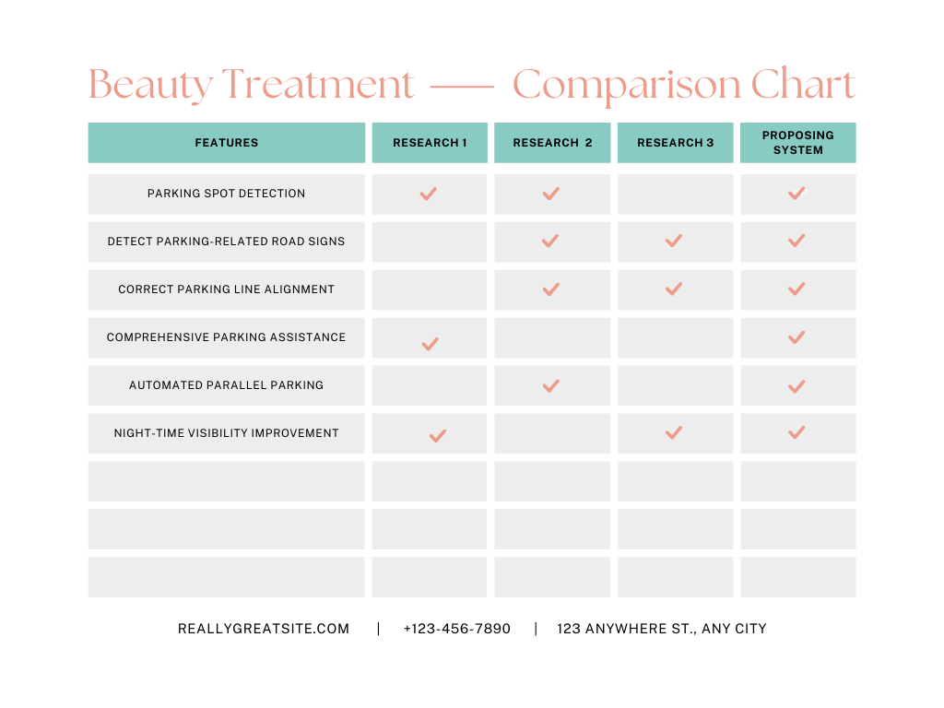
Research Gap
IT21231728 | Neelawala P.K.N.G.K.B. | CDAP_24_25J_197

Slide 37
Research Questions
How can a comprehensive parking assistance system be developed to improve parking accuracy and efficiency by integrating parking spot detection, parking-related road sign detection, and parking line alignment?
IT21231728 | Neelawala P.K.N.G.K.B. | CDAP_24_25J_197

Slide 38
Specific Objective
Develop an advanced parking spot and sign detection system.
Sub Objectives
Parking Spot Detection
Parking related road sign detection
Parking Line Alignment
IT21231728 | Neelawala P.K.N.G.K.B. | CDAP_24_25J_197

Slide 39
Methodology
IT21231728 | Neelawala P.K.N.G.K.B. | CDAP_24_25J_197

Slide 40
Technologies to be used
Hardwares
Camera (High-resolution cameras for capturing real-time images).
Softwares
OpenCV, TensorFlow (Image Processing Libraries).
Convolutional Neural Networks (CNN) for object detection.
Python for scripting, integration, and model development.
JavaScript, HTML5, CSS for developing the intuitive user interface.
IT21231728 | Neelawala P.K.N.G.K.B. | CDAP_24_25J_197

Slide 41
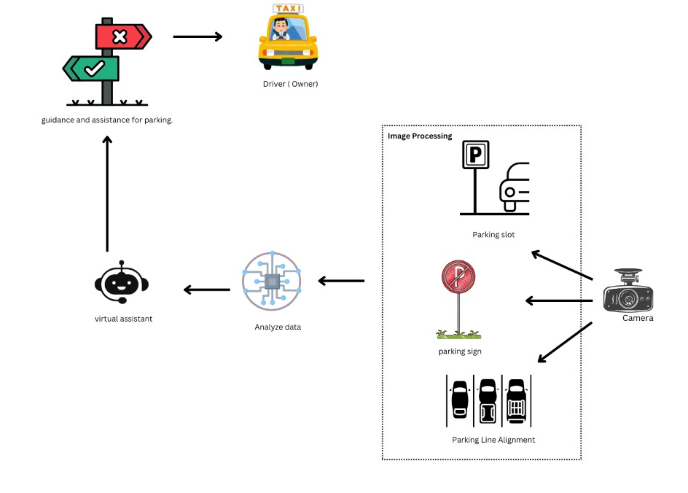
System Diagram
IT21231728 | Neelawala P.K.N.G.K.B. | CDAP_24_25J_197

Slide 42
Functional Requirements
Accurate parking spot detection in various environments.
Detection and interpretation of parking-related road signs.
Feedback mechanism for correct parking line alignment.
IT21231728 | Neelawala P.K.N.G.K.B. | CDAP_24_25J_197

Slide 43
Non-Functional Requirements
High accuracy and reliability.
Low latency in processing and feedback.
Scalability to accommodate different parking environments.
Robustness to operate under various weather conditions.
IT21231728 | Neelawala P.K.N.G.K.B. | CDAP_24_25J_197

Slide 44
Personal Requirements
Project Manager - Oversees project planning, execution, and delivery.
Software Developers - Develop and integrate the software modules.
Data Scientists - Develop and train machine learning models.
Test Engineers - Test the system for accuracy, performance, and reliability.
IT21231728 | Neelawala P.K.N.G.K.B. | CDAP_24_25J_197

Slide 45
Commercialization
Notify the vehicle market about the product.
Create blogs and articles and publishing.
Social media marketing plan.
IT21231728 | Neelawala P.K.N.G.K.B. | CDAP_24_25J_197

Slide 46
Budget
Resourses | Amount (LKR)
Accessories Cost | 3000
Electricity cost | 2600
Internet Cost | 3000
Travelling Cost | 8000 (for all)
IT21231728 | Neelawala P.K.N.G.K.B. | CDAP_24_25J_197

Slide 47
References
[1] A. Gunathilake, S. Perera, and M. Jayasinghe, "Parking spot detection in urban areas using machine learning," *Sri Lankan Journal of Applied Sciences*, 2021.
[2] R. Perera and W. Wijesinghe, "Detection of parking-related road signs using image processing," *Int. J. Adv. Comput. Sci. Appl.*, 2020.
[3] D. Fernando, H. De Silva, and N. Abeywickrama, "Correct parking line alignment feedback system," in *Proc. Int. Conf. Smart Comput. Syst. Eng.*, 2019.
IT21231728 | Neelawala P.K.N.G.K.B. | CDAP_24_25J_197

Slide 48
Nayanathara R.M.C. | IT21365300
BSc (Hons) in information Technology Specialized in Information Technology
IT21365300 | Nayanathara R.M.C. | CDAP_24_25J_197

Slide 49
Introduction
Real time comprehensive blind spot identification with distance measurement
System to detect objects around the vehicle to prevent collisions.
Focuses on accurately measuring the distance to objects around the vehicle.
Aims to provide the driver with assistance during overtaking maneuvers.
Focuses on alerting the driver about upcoming traffic jams.
IT21365300 | Nayanathara R.M.C. | CDAP_24_25J_197

Slide 50
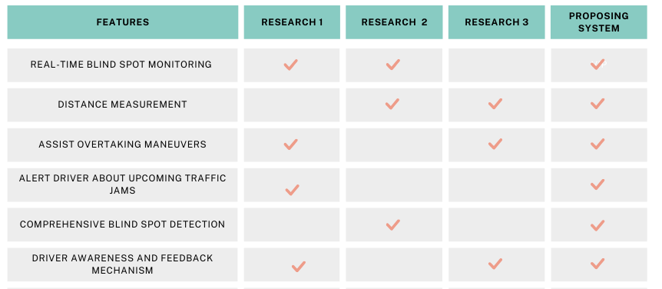
Research Gap
IT21365300 | Nayanathara R.M.C. | CDAP_24_25J_197

Slide 51
Research Questions
What are the key design and implementation considerations for developing a comprehensive blind spot detection system that integrates real-time object detection and distance measurement to enhance vehicle safety in Sri Lankan vehicles ?
IT21365300 | Nayanathara R.M.C. | CDAP_24_25J_197

Slide 52
Specific Objective
Develop a comprehensive real-time blind spot monitoring system with integrated distance measurement, assistive overtaking features, and traffic jam.
Sub Objectives
Test distance measurement accuracy.
Evaluate the effectiveness of overtaking assistance.
Analyze the impact of traffic jam alerts on driving efficiency.
IT21365300 | Nayanathara R.M.C. | CDAP_24_25J_197

Slide 53
Methodology
IT21365300 | Nayanathara R.M.C. | CDAP_24_25J_197

Slide 54
Technologies to be used
Hardwares
Camera (High-resolution cameras for capturing real-time images).
Softwares
OpenCV, TensorFlow (Image Processing Libraries).
Convolutional Neural Networks (CNN) for object detection.
Python for scripting, integration, and model development.
JavaScript, HTML5, CSS for developing the intuitive user interface.
IT21365300 | Nayanathara R.M.C. | CDAP_24_25J_197

Slide 55
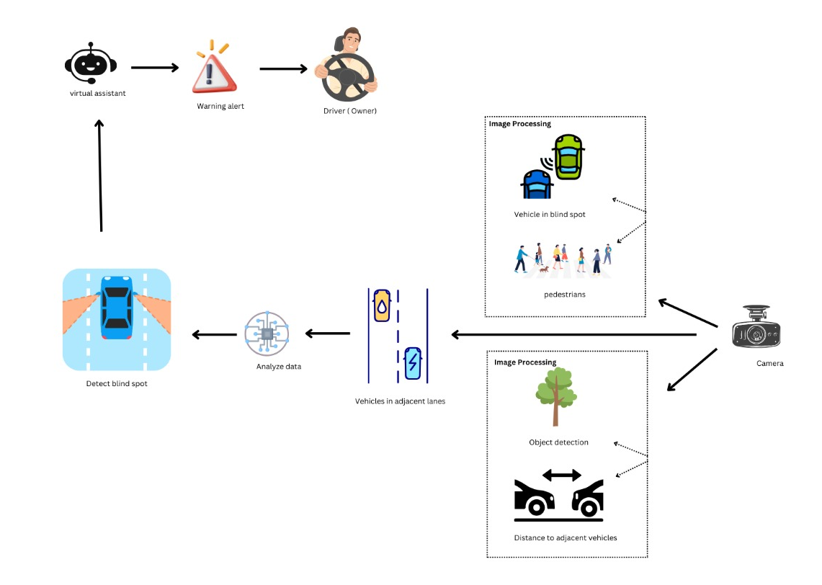
System Diagram
IT21365300 | Nayanathara R.M.C. | CDAP_24_25J_197

Slide 56
Functional Requirements
Real-time detection of objects in the blind spot.
Accurate distance measurement of detected objects.
Alerts for upcoming traffic jams.
Assistance during overtaking maneuvers.
Intuitive user interface for real-time feedback.
IT21365300 | Nayanathara R.M.C. | CDAP_24_25J_197

Slide 57
Non-Functional Requirements
High reliability and accuracy.
Low latency in real-time processing.
Robustness to various weather conditions.
IT21365300 | Nayanathara R.M.C. | CDAP_24_25J_197

Slide 58
Personal Requirements
Project Manager (Ensuring it stays on schedule and meets the objectives).
Software Engineers (Development for real-time processing and UI).
QA Specialists (Test the system for reliability, accuracy, and performance).
UI/UX Designers (Design an intuitive and user-friendly interface).
IT21365300 | Nayanathara R.M.C. | CDAP_24_25J_197

Slide 59
Commercialization
First, recognize the target audience.
Create a blog for our application.
Add our application to review websites.
Create a social media marketing plan.
IT21365300 | Nayanathara R.M.C. | CDAP_24_25J_197

Slide 60
Budget
Resourses | Amount (LKR)
Accessories Cost | 5500
Electricity cost | 1400
Internet Cost | 4500
Travelling Cost | 8000 (for all)
IT21365300 | Nayanathara R.M.C. | CDAP_24_25J_197

Slide 61
References
[1] "Object Detection for Road Safety," University of Moratuwa, 2021. This study focused on developing a basic object detection system using image processing techniques but did not integrate real-time monitoring or distance measurement.
[2] "Traffic Alert Systems in Sri Lanka," University of Peradeniya, 2022. This research highlighted the development of traffic alert systems to inform drivers of upcoming traffic jams but did not link this with blind spot detection capabilities.
[3] "Enhancing Road Safety with ADAS," University of Colombo, 2023. This paper discussed various ADAS features but lacked a comprehensive approach to integrating blind spot detection with distance measurement.
IT21365300 | Nayanathara R.M.C. | CDAP_24_25J_197

Slide 62
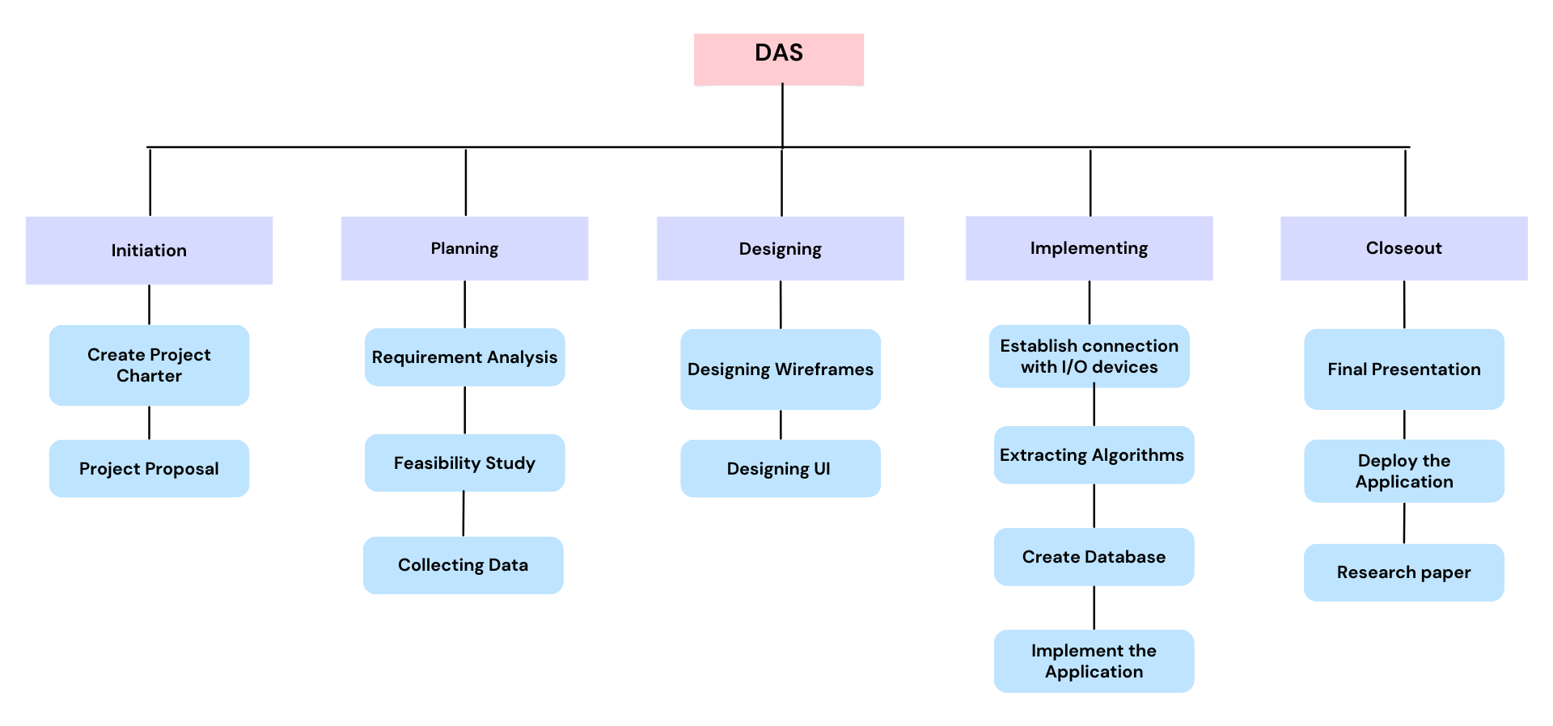
Work Breakdown Structure

Slide 63
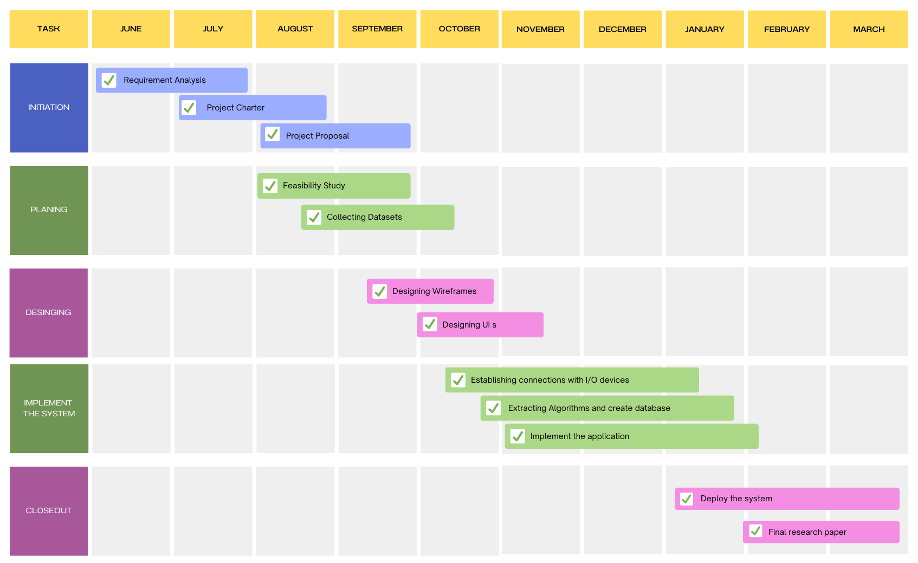
Gannt Chart

Slide 64
Thank you

